Slide 1
Advertisements Provider Data Aggregator

Slide 2
INTRODUCTION
The object of all business is to make a profit and increase the sales product. This only possible if the product is wieldly polished to the user an the final consumers. Advertisement denotes a specific attempt to popularize a specific product or service at certain cost, that is method of publicity.
Why project “Ad Provider Data Aggregator” Advertisement is some way publicity of customer product. The owner of the product will be in profit if an only if advertising is in proper manner and keeping track of advertising there product.
Here in our project, we are giving graphical representation and analysis of there records.
From graphical representation , they can see whether our business is in loss or in profit.

Slide 3
Proposed System
By using system, customers can display their Advertises in specific Blogger.
System will keep track of all the respected websites where Ads have been flashed.
Also it maintains the count collected by every website for the particular Ad through CTR (click-through rate).
System will provide this service for specific period of time.
Required reports will be generated.
The system will help the customer, to keep track of the responses by viewing the detail analysis, of the progress of the Advertisement.

Slide 4
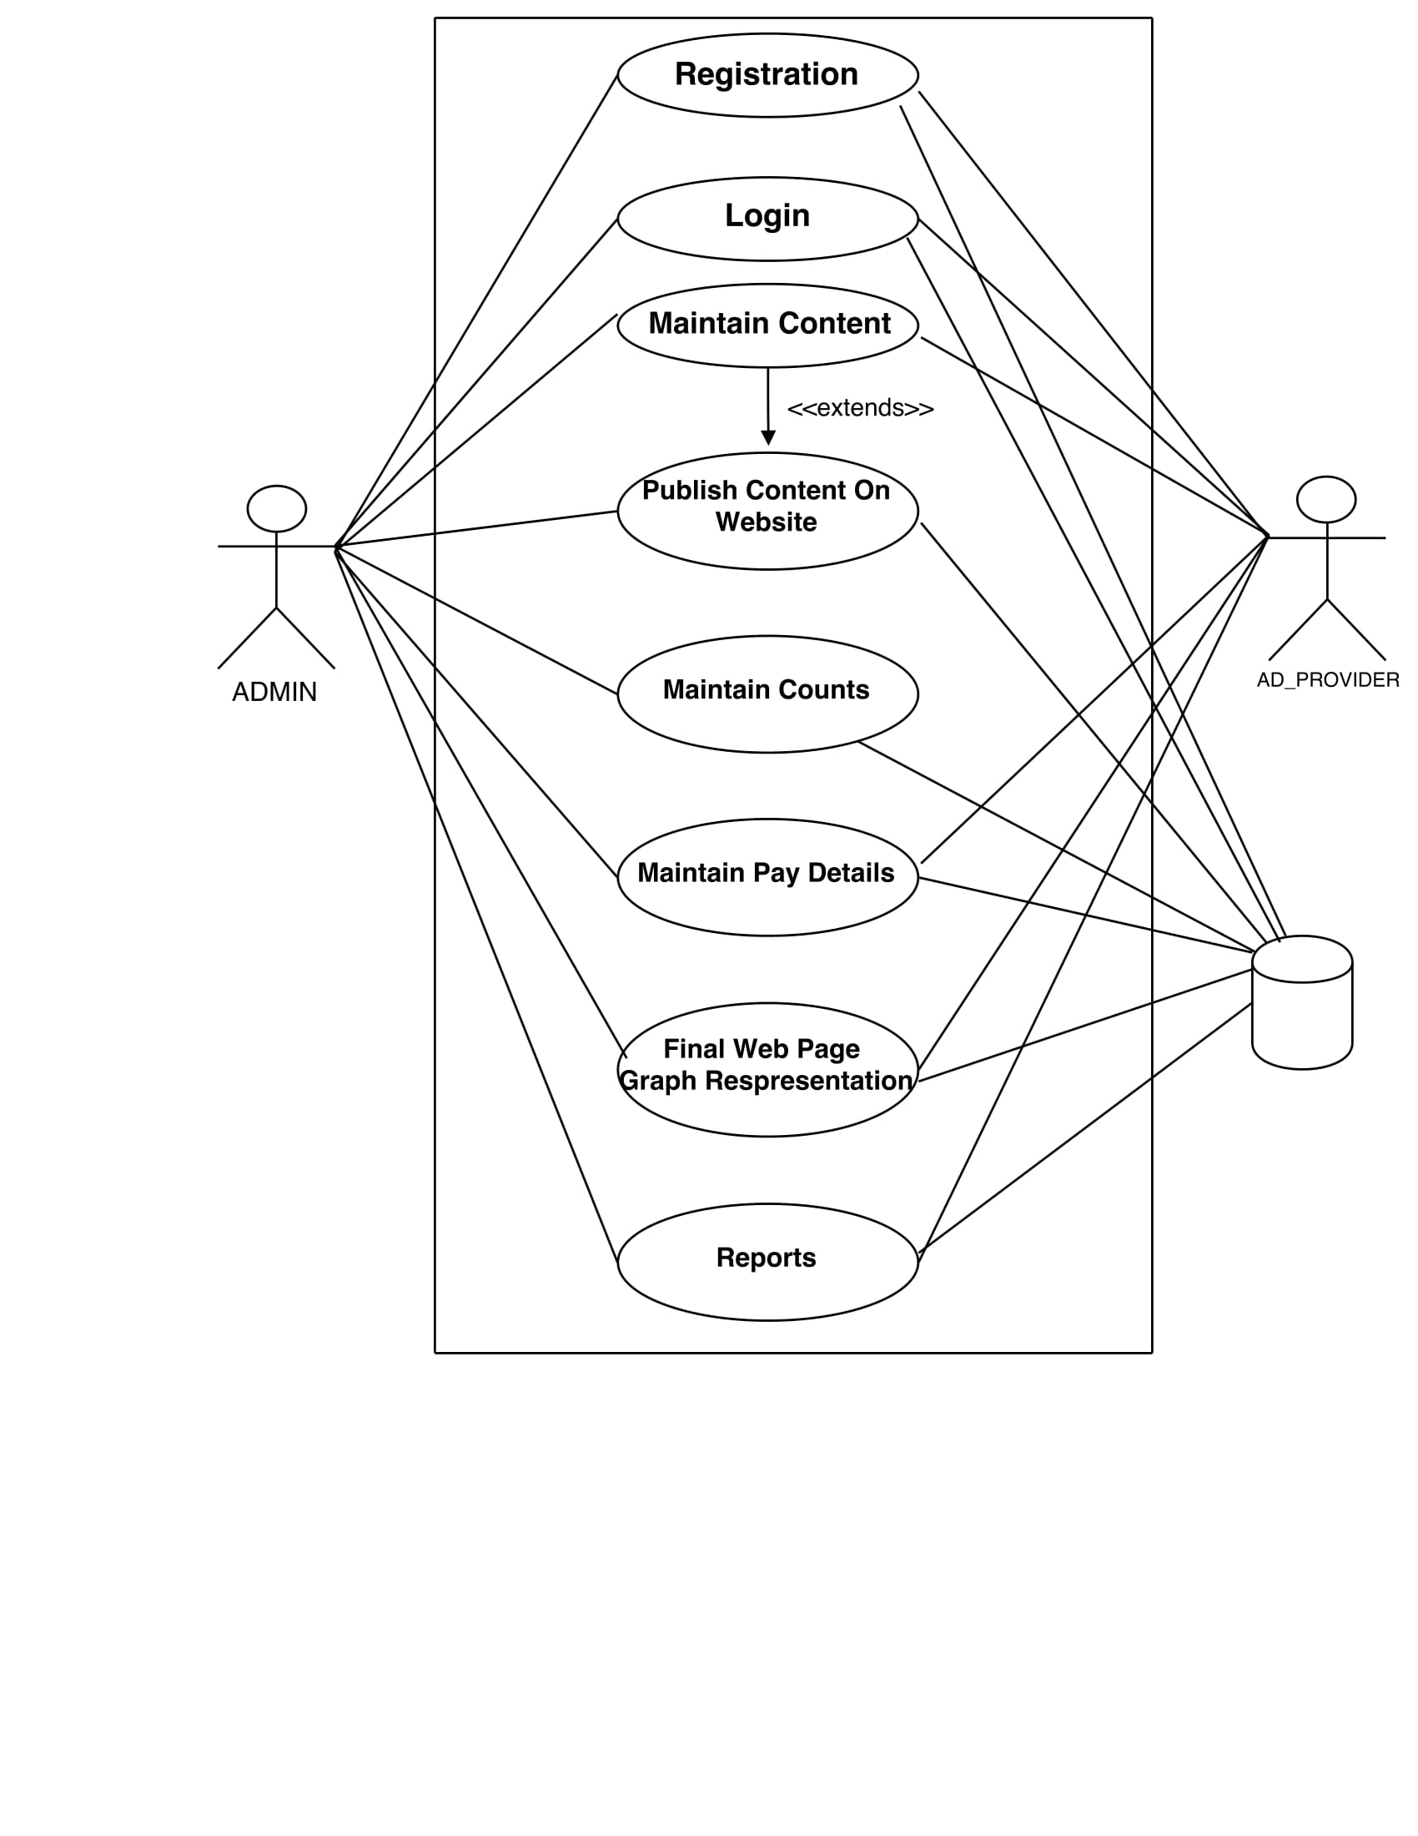
UseCase Diagram

Slide 5
System Specifications
Software Configuration:-
Front end- Java Runtime Environment, Net beans 7.0.1.
Back end- : MySQL Server
Operating System:- Windows XP
Hardware Configuration:-
Processor: Pentium(R)Dual-core CPU
Hard Disk: 1 GB minimum.
RAM: 256 MB minimum.

